Slide 1


Project Presentation
Suspect Image Retrieval Using Facial
Recognition Through CCTV Footage
Team Members:
Aditya S K- 4SF21AD002
Jagan Mohan Prakash - 4SF21AD021
Tejas B G- 4SF21AD055
Under the Guidance of:
Mrs. Kavyashree G
Assistant Professor
Department of CSE(AI&ML) SCEM Mangaluru
Department of Computer Science and Engineering
(Artificial Intelligence and Machine Learning)

Slide 2
Introduction
Image and video classification is an open research domain for the computer vision research community. There are various application domains of image and video classification, such as:
- Industrial automation - Face recognition - Medical image analysis - Security surveillance - Content-based multimedia analysis - Remote sensing
The recent focus of research for image and video analysis is the use of deep learning models and high-resolution images to design effective decision support systems that can be used with IoT.

Slide 3
Objective
The objective of this project is to develop an advanced and efficient system for suspect image retrieval using facial recognition technology.
The system aims to enhance law enforcement capabilities by accurately identifying and retrieving images of suspects from large databases based on facial features.
This will involve implementing state-of-the-art facial recognition algorithms

Slide 4
Literature Survey
Research paper | Author | Abstract
Forensic Video Analysis: Passive Tracking System for Automated Person of Interest (POI) Localization | AFTAB KHAN 1,SAKHI REHMAN1 | Videorecorders record the output of each security camera.A manual scan of the video footage requires a considerable amount of manpower and time.
Criminal face recognition using video surveillance | Prasad Laxman Salokhe | the identification of the criminals takes a lot of time
Room Security System with Face Recognition using Local Binary Pattern Histogram Algorithm based on the Internet of Things | Turkhamun Adi Kurniawan1, Istiqomah Sumadikarta2 | An Internet of Things-based security system and OpenCV technology have been developed to improve the efficiency and ease of monitoring video footage from CCTV.
Deep Face Recognition | Omkar M. Parkhi | The goal of this paper is face recognition– from either a single photograph or from a set of faces tracked in a video.

Slide 5
Literature survey
Human and Machine Recognition of Faces: A Survey | RAMA CHELLAPPA, FELLOW, IEEE, | The goal of this paper is to present a critical survey of existing literature on human and machine recognition of faces
An investigation into the use of CCTV footage to improve likeness in facial composites | Ness, H & Bruce, V | Facial composites are an important investigative tool and have been used in numerous high-profile cases (e.g. Yorkshire Ripper).
CCTV Footage De-identification for Privacy Protection: A Comprehensive Survey | Sekione Reward Jeremiah1, Oscar Enrique Llerena Castro1 | Privacy preservation is a significant concern in our data driven society, both in the social and political spheres.
Intelligent CCTV for Mass Transport Security: Challenges and Opportunities for Video and Face Processing | Conrad Sanderson∗, Abbas Bigdeli∗, | CCTV surveillance systems have long been promoted as being effective in improving public safety.
Perspective Study on Content Based Video Retrieval | C. Victoria Priscilla1 and D. Rajeshwari2 | The Closed-Circuit Television (CCTV) footages plays a vital role in criminal investigations which helps to reduce cost, time and effort but still it has many challenges to face such as monitoring multiple cameras simultaneously,

Slide 6
Literature Survey
Room Security System with Face Recognition using Local Binary Pattern Histogram Algorithm based on the Internet of Things | Turkhamun Adi Kurniawan1, Istiqomah Sumadikarta2 | An Internet of Things-based security system and OpenCV technology have been developed to improve the efficiency and ease of monitoring video footage from CCTV.
An investigation into the use of CCTV footage to improve likeness in facial composites | Ness, H & Bruce, V | Facial composites are an important investigative tool and have been used in numerous high-profile cases (e.g. Yorkshire Ripper).
Criminal face recognition using video surveillance | Prasad Laxman Salokhe | the identification of the criminals takes a lot of time
Intelligent CCTV for Mass Transport Security: Challenges and Opportunities for Video and Face Processing | Conrad Sanderson∗, Abbas Bigdeli∗, | CCTV surveillance systems have long been promoted as being effective in improving public safety.
Perspective Study on Content Based Video Retrieval | C. Victoria Priscilla1 and D. Rajeshwari2 | The Closed-Circuit Television (CCTV) footages plays a vital role in criminal investigations

Slide 7
Methodology
Read the image.
Load known encoding.
Convert image into RGB color.
Detect the coordinate of the bounding box of the face from the image to extract the face.
Compute the facial embedding or features of each image detected during training.
Extract the face from the image.
Match the input face to the training dataset.
Decide if the face is known or not.
Label the image with the folder name if the face is known; otherwise, mark it as unknown.

Slide 8
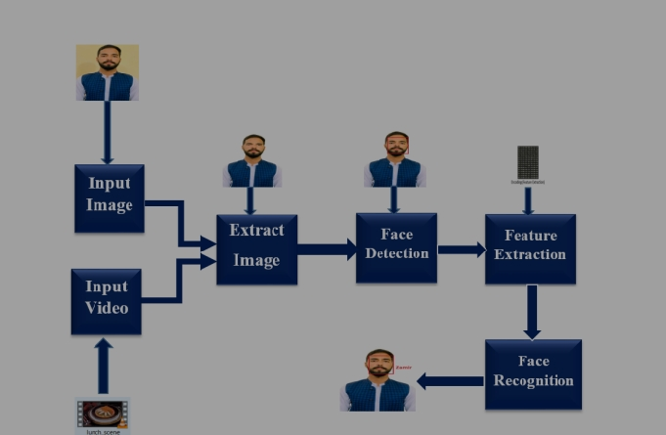
Architectural Design

Slide 9
References
1 | P. N. Belhumeour, J. P. Hespanha and D. J. Kriegman, "Eigenfaces vs. Fisherfaces: Recognition using class specific linear projection", IEEE Tr., vol. PAMI-19, no. 7, pp. 711-720, 97.
2 | A. P. Dempster, N. M. Laird and D. B. Rubin, "Maximum likelihood from incomplete data via the em algorithm", Journal Royal Statistical S., 77.
3 | D. L. Swets and J. J. Weng, "Using discriminant eigenfeatures for image retrieval", IEEE Trans., vol. PAMI-18, no. 8, pp. 831-836, 96.
4 | L. A. Liporace, "Maximum likelihood estimation for multivariate observations of Markov sources", IEEE Trans., vol. IT-28, no. 5, pp. 729-734, 82.

Slide 10
5 | K. Fukunaga, Introduction to statistical pattern recognition, Academic Press, 90.
6 | M. Kirby and L. Sirovich, "Application of the Karhunen-Love procedure for the characterization of human faces", IEEE Trans., vol. PAMI-12, no. 1, pp. 103-108, 90.
7 | A. Martínez and R. Benavente, The AR face database, June 98.
8 | N. Oliver, A. Pentland and F. Bérard, "LAFTER: Lips and face real time tracker with facial expression recognition", Proc. CVPR, 97.
9 | B. Rosario and A. Pentland, "A Bayesian computer vision system for modeling human interactions", Proc. ICVS, 99.
10 | A. Pentland, T. Starner, N. Etcoff, N. Masoiu, O. Oliyide and M. Turk, "Experiments with eigenfaces", looking at people workshop of IJCAI 93.

Slide 11
11 | A. Pentland, T. Starner, N. Etcoff, N. Masoiu, O. Oliyide and M. Turk, "Experiments with eigenfaces", looking at people workshop of IJCAI 93.
12 | R. D. Rimey and C. M. Brown, "Controlling eye movements with hidden Markov models", Int. J. Comp. Vision, vol. 7, no. 1, pp. 47-65, 91.
13 | T. Starner and A. Pentland, "Visual recognition of american sign language using hidden Markov models", Int. workshop AFGR, 95.
14 | D. L. Swets and J. J. Weng, "Using discriminant eigenfeatures for image retrieval", IEEE Trans., vol. PAMI-18, no. 8, pp. 831-836, 96.
15 | M. Turk and A. Pentland, "Eigenfaces for recognition", Journal Cognitive Neuroscience, 91.
16 | T. Vert, "Synthesis of novel views from a single face image", Int. J. Comp. Vision, 98.

